Slide 1
CLASS IX ARTIFICIAL INTELLIGENCE PART A UNIT 3- ICT SKILLS

Slide 2
Unit 1. Role of ICT in Day-to-Day Life
INTRODUCTION TO ICT :Information Technology means creating, managing, storing and exchanging information. It includes all technologies that can be used to deal with information. ICT stands for Information and Communication Technology which deals with the use of electronic media like computer, smart phone, iPad, etc. to store process, and retrieve data or information.
ROLE AND IMPORTANCE OF ICT IN PERSONAL LIFE AND AT WORKPLACE
Information Technology has become a part of everyday life. ICT applications are found in every field – education, health, business, design, manufacturing, science, environment. You can create a project report, do office work, send messages, read books, manage daily planner, play games, listen to music, watch movies, pay bills, book tickets, buy products, and the list in endless.
ICT at Home : A computer can be used at home to play games, search information, listen to music, watch movies, send or receive email, maintain household accounts. A device with internet connection can be used to do online shopping, pay bills, do e-banking etc.
ICT in education: ICT for education refers to the development of information and communications technology specifically for teaching/learning purposes. ICT has also become integral to the teaching-learning process. ICT, to some extent, has replaced traditional chalkboards with interactive digital whiteboards. It is used for teaching-learning and assessment. The concept of “flipped classroom” is becoming popular in many countries where students watch lectures at home on the computer and use classroom time for more interactive exercises.
Using ICT tools can lead to
• higher order thinking skills
• provide creative and individualized options for students to express their understandings
• Students are better prepared to deal with ongoing technological change in society and the workplace.

Slide 3
Some of the advantages of ICT in education are:
• Complex topics can be easily explained to the students with the help of pictures, videos, presentations, etc.
• Images and videos used for teaching improves the retention memory of the students.
• Presentations can make the lessons interesting.
• Practical demonstration can be given to the students.
• If the teaching process in the class is interactive, it will make the lesson more enjoyable.
• An e-learning program allows students to learn at their own pace, at any convenient time, and from any place
ICT in Healthcare
Through the right communication media, a doctor can easily deliver treatment and care to the patient who is located far away. Doctor can also continuously monitor the patient’s history, diagnostic report, and track the current health condition. The Doctor can also interact with patient, recommend to take medical examination and prescribe medicine.
Using the ICT tool or a suitable communication system, government can make efforts to create awareness among the public about the communicable diseases, prevention measures and various current diagnostic & etc.
ICT in healthcare research helps to find the possible prevention measures to eradicate and reduce the spread of diseases.
Through ICT, the traditional healthcare systems can be eliminated and new models can be formed for effective quality care.
Hospitals can use different electronic media to store medical data. This helps to retrieve the information easily. This data can be transferred to the patient or to the Doctors for consultation.
Computer based machines are used for MRI, CT-scan, ultrasound are done in hospitals, diagnostic centres, to diagnose the diseases.
Life support systems are provided to the patients
You can search information on any disease, medicines, etc. on the internet

Slide 4
ICT in Governance
ICT in governance means using Internet, other electronic media buy the central and state governments, by local administrative bodies to improve the efficiency, transparency, efficiency of the government. Many government services are available online. Electronic voting for elections has replaced the traditional voting slip.
ICT in governance can be help:
Deliver government services efficiently
E-governance sites enable people to perform various tasks such as filling a form, applying for passport, paying bills, property tax, etc. even sitting at home.
ICT in Business
ICT in business can be used for the following purposes:
Keep records of the stock
Prepare accounts and balance sheets
Maintain database of staff and customers
E-commerce enables people to buy and sell products online. This service is available 24 x 7.
E-banking facility helps to make banking transactions at any time of the day .

Slide 5
ICT in our daily life (examples) :ICT has a great impact in our daily life. Some of the uses of ICT in our daily life are given below:
• We can read newspapers online.
• We can get connected with our friends, relatives or even family members far away from us using email, messenger, video conferencing etc.
• With the introduction of video conferencing, business meetings are now easier.
• Nowadays people use mobile phone apps to meet and connect with new and old friends.
• Social networks like Facebook.com have played a big role in connecting both old and new relationships.
• We can access a full library of educational material via a mobile app or website on any smartphone or iPad.
• Technology has also made the buying and selling of goods and services flexible and a lot safer.
• Most banks now offer online banking facilities. People make use of this service daily to manage their finances.
• Most businesses use online banking facility to pay employees and transfer money.

Slide 6
ICT Tools
ICT tools are devices that are used in Information and communication technology. For example, computer, smart phone, radio, television, iPad, tablets, etc.
Some of these are discussed below:
Mobile : Mobile phones are the easiest and simplest way of communication. It is small in size, lightweight and portable. You can stay in touch with your friends, relatives, anytime and anywhere.
Mobile phones are useful in studies. Students can access the internet on their mobile phones and get knowledge on any topic.
You can even create documents, make presentations, etc on your smart phones as you do on your computer.
Tablets: Tablets are small personal computers with a touch screen. Tablets allows user to input data and instructions through keyboard or mouse. Learning software called apps can be downloaded onto tablets. You can also watch videos relevant to your subject.
Radio :Radio is the oldest tool used to provide entertainment and information to people. You can listen to music, radio shows, etc. on radio.
TV : Television is another important ICT tool. You can watch music, view programs, etc. on television.
Newspaper :Newspaper is another most important ICT tool. News related to all the issues , national, international, sports, space, etc, are printed in newspapers.

Slide 7
Email :Email is the most common way of communication in today’s world. It is the official way of communication. Some of the advantages of using email are:
You don’t have to pay anything extra for sending or receiving email. You just pay for the internet connection.
You can send bulk mails
The receiver may not be online when you send the email.
You can send documents, presentations, images, videos, etc. as an attachment to email.
When you send an email, it reaches, the receiver at any part of the world in few seconds.
Interactive White Boards (Smart Boards) :These boards a allow to project computer . Also handwritten notes can be taken on the board and saved for later use.
E-readers :E-readers are electronic devices that can hold hundreds of books in digital form. E-readers are portable, have a long battery life.

Slide 8
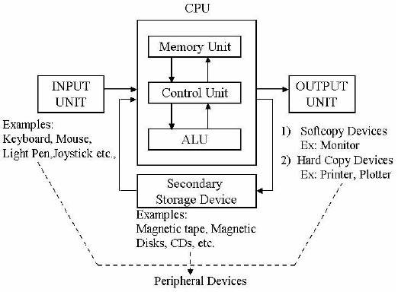
Computer system
A computer system is a programmable machine designed to store and retrieve information and perform arithmetic and logical operations to produce meaningful results in desired format.
HARDWARE AND SOFTWARE
A computer system comprises of hardware and software.
Computer hardware – Physical parts of a computer such as Input devices, output devices, central processing unit and storage devices are called computer hardware.
Computer software – Software are the programs or applications that run on computer. For example, MS Word, MS PowerPoint, Operating systems, etc.

Slide 9
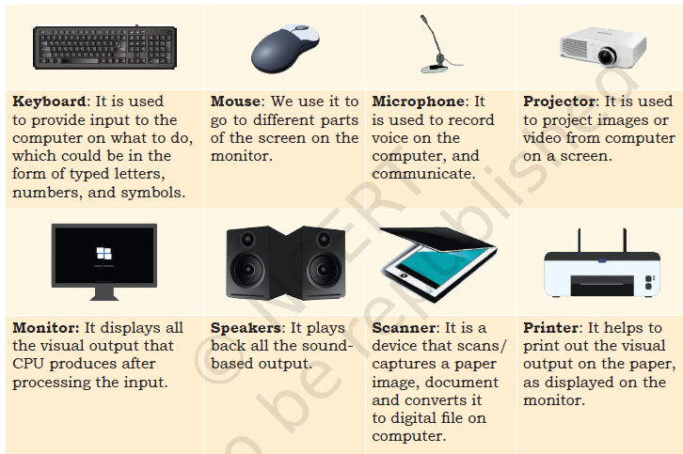
Input Devices :Input devices are used for entering data or instructions into the computer
Output devices: Output devices bring information from the computer to the user.
Common Peripheral units are:

Slide 10
The Central Processing Unit (CPU) :The Central Processing Unit is the brain of the computer system. Functions of Central Processing Unit are:
• It controls the sequence of operations within the computer
• It gives commands to other parts of the computer
• It controls the use of main memory for storing data and instructions
It consists of the following main units: Processing unit (Arithmetic and Logic unit (ALU)) , Control Unit (CU) , Memory Unit
Control unit: It acts like a receiver and a manager of a company. It receives inputs from user and controls different parts to do the operations required.
Processing unit: It acts as an accountant of a company and performs all the mathematical and logical calculations.
Memory unit: It acts as the storage room of a company, where data is stored temporarily (RAM) as well as for a long time (ROM).

Slide 11
RAM ROM AND FLASH MEMORY

Slide 12
Motherboard
Motherboard, also referred to as a system board, is the main circuit board inside a computer. It connects input, processing and output devices.
Some other important parts of a computer system are storage devices, ports and connections.
Storage devices
In order to transfer files from one computer to another one, you need smaller storage devices which you can carry easily from one place to another.
These storage devices are used to store digital information. The commonly used storage devices are USB flash drive, hard disk, CD, DVD, etc.
They mainly differ in their storage capacity (how much data they can store).
Data is stored in the form of bits and bytes. Bit (Binary Digit, represented by 0 or 1) is the smallest storage unit.
Eight bits combined together form a byte, which in turn represents a character (numerals/letters/symbols).
• 8 bits make a byte and 1024 bytes make a kilobyte (KB).
• 1024 KB make 1 megabyte (MB)
• 1024 megabyte make 1 gigabyte (GB)
• 1024 gigabyte make 1 terabyte (TB)

Slide 13
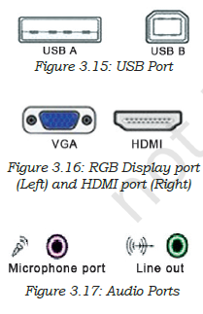
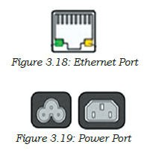
Ports and connections
The slots or channels into which we connect the mouse/keyboard/external hard disk wires are called ports. Thus, ports help us connect input, output and storage devices in a computer system.
• Universal serial bus or the USB port connects peripheral devices, such as a mouse or a keyboard or a printer to a computer using the cable.
• Display connects the monitor, or any display unit, to the computer using the cable. These can be of different types, like Video Graphics Array (VGA) and High Definition Multimedia Interface (HDMI), depending on the requirement.
• Audio ports help to connect microphone, speakers, and headphones to a computer system. Often, the speaker and headphone port is called the line out port, i.e., it is meant for sound output.
• Ethernet port is used for connecting the system to high speed Internet cable.
• Power port is used for connecting the computer system to the power supply.

Slide 14
Procedure for starting and shutting down a computer
When a computer is switched on, it performs some basic processes/ functions, before it is ready to take instructions from the user.
To start a computer, press the Power button on the CPU. This will start the Windows operating system and display the Windows desktop on the monitor.
Login and logout:A login and password is like a key to the lock which allows you to use the computer. When you login to the computer with your login-ID and password the computer knows that you are an authorised person and allows you to work on the applications in the computer.
Once you finish working, you must log out or sign out so that no one else can see your work.
Shutting down a computer: You can shut down the computer in Ubuntu by clicking “Systems” at the top right and then click on Shut Down. When you click Shut down, the Operating System will close all the applications and turn off the computer.

Slide 15
Computer hardware and software
A computer system consists of two main parts—the hardware and the software.
The physical parts that we can see and touch are called the hardware. It is the machinery of a computer. These are the keyboard, monitor, CPU, etc.
The software that we cannot see makes the hardware work the way we want. For example, as shown in Figure, the monitor is a physical device or the hardware. When we start a program, it is displayed on the monitor. This is done by the software which displays things on monitor.
The most important software in any computer is the Operating System (OS). This is the software that starts working as soon as we switch on a computer. It displays the desktop on the monitor. Some of the most commonly used operating systems for laptops and desktop are Ubuntu, Microsoft Windows and Mac OS.
Mobile devices also have operating system that helps them perform their functions. Some of the mobile operating systems are Apple iOS and Google Android
All the computer applications, such as browsers, games, Office tools, etc., are also software programs that perform a particular function.

Slide 16
Using the Keyboard
A keyboard is an input device used to type text, numbers and commands into the computer.
Function Keys- Keys labeled from F1 to F12 are function keys. You use them to perform specific functions.
(a) Control keys: Keys, such as Control (CTRL), SHIFT, SPACEBAR, ALT, CAPS LOCK and TAB, are special control keys
(b) Enter key: The label on this key can be either ENTER or RETURN, depending on the brand of computer that you are using. You use the ENTER or the RETURN key to move the cursor to the beginning of a new line.
(c) Punctuation keys: Punctuation keys include keys for punctuation marks, such as colon (:), semicolon (;), question mark (?), single quotation marks (‘ ’), and double quotation marks (“ ”).
(d) Navigation keys: Keys, such as the arrow keys, HOME, END, PAGE UP, and PAGE DOWN are navigation keys
(e) Command keys: Keys, such as INSERT (INS), DELETE (DEL), and BACKSPACE are command keys. When the INSERT key is turned ON, it helps you overwrite characters to the right of the cursor.
(f) Windows key: Pressing this key opens the Start menu

Slide 17
Using a Mouse
A small device that you can use to move, select and open items on your computer screen.
Roll Over or Hover - Some actions can be done by simply rolling over or hovering over an item. When you bring the mouse over a file in File Explorer, it will show the details of that file
Point and Click - As you move the mouse on your desk, a pointer moves correspondingly on your screen. When you click a particular file, it gets selected
Drag and Drop - To move an item, you need to click it, and then holding the mouse button down, move the item to a new location. After you move the item to the new location, you release the mouse button. This is called drag and drop.
Double-click - Double-clicking means to quickly click the left mouse button twice. When we double-click on a file, it will open the file.

Slide 18
Performing Basic File Operations
Files and Folders - All information stored in a computer is kept in files. Each file is given a file name and has a file name extension that identifies the file type. Example: .txt, .jpg, .mp3.
A folder is a location where a group of files can be stored
Basic Shortcuts
CTRL+z — undo
CTRL+y — redo
CTRL+a — select all
CTRL+x — cut
CTRL+c — copy
CTRL+v — paste
CTRL+p — print
CTRL+s — save.

Slide 19
Communication and Networking — Basics of Internet
The Internet is a huge network of computers around the world. Using the Internet you can get any information that is stored in a web page on the World Wide Web.
If your computer is connected to the Internet, you say that your computer is online. With the help of the Internet, you can gather a lot of knowledge which is
available on it.
The knowledge is stored in a big library/ storehouse, called the World Wide Web (WWW) or the Web. It is a collection of different websites that you can view if you are connected to the Internet.
Uses of the Internet
Search information
Entertainment
E-mail and chatting
Social networking
Shopping
Online learning
Online booking:
Online banking:

Slide 20
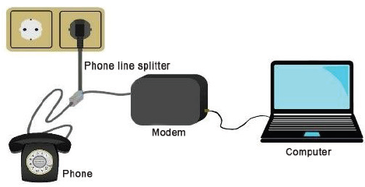
Connecting to the Internet
To connect to the Internet, we need:
(a) A device, such as a computer, laptop or mobile.
(b) A connection device, i.e., a modem.
An Internet Service Provider (ISP)─i.e., the telephone company which provides the Internet connectivity using the phone lines or a wireless network.
Types of connections
(a) Wired connections: When our computer is connected to the Internet using a wire, it is called a wired connection.
We use Ethernet cables (cables used for connecting to the Internet) to connect to the modem which connects to the ISP using a phone line.
(b) Wireless connection: You can also connect your computer to the Internet using wireless technology .
Laptops need a wireless Internet card to connect to a modem with using any cables.

Slide 21
Bandwidth
Bandwidth is the amount of data that can be transmitted over a network in a certain amount of time. The amount of data that your network can
receive or send depends on its bandwidth.
In case of digital devices, the bandwidth is usually expressed in bits per second (bps) or bytes per second and in case of analog devices, the bandwidth is expressed in cycles per second, or Hertz (Hz).
Data transfer speed over the networks (including the internet) is calculated in terms of bits per second.
1 Kbps (kilo bits per second) = 1000 bits per second
1 Mbps (mega bits per second) = 1000 kilo bits per second
1 Gbps (giga bits per second) = 1,000 mega bits per second

Slide 22
World Wide Web
The World Wide Web (WWW) or simply the Web is a huge collection of information. It is a vast network of linked hypertext files, stored on computers throughout the world, that can provide a computer user with information on a huge variety of subjects. Thus, it serves as a platform through which users can use or share information. It is made up of
• A web page
• A web browser
• A system to transfer information between the web browser and the web pages
INTERNET BROWSER : A web browser or internet browser is a program that is used to view the web sites. It acts as an interface between the web server and the world wide web. Some commonly used web browser are – Google Chrome, Microsoft Internet Explorer, Microsoft Edge, opera, etc.
A web browser performs the following tasks:
It connects to the web server and sends a request for the information
2. It displays the information on the computer.
WEB SITE :A web site is a collection of two or more related web pages. Web pages of a web site are linked together through hyperlinks.

Slide 23
WEB PAGE : An individual page of a web site is called a web page. It is written in a special computer language called HTML (Hyper text markup Language).
There are two types of web pages:
Static web page is a web page in which all the information is presented to the user exactly as it is stored. For example, any tutorial web site.
Dynamic web page is a web page which shows different content each time you visit the page. For example, shopping web sites.
Home Page : The first web page of a website is called the home page

